Slide 1

Multi-Agent Architecture for News Authoring Agent

Slide 2
Team Details
Div | USN | Name
F | 01FE22BCI007 | Vignesh Chougule
F | 01FE22BCI016 | Disha S Kalyanshettar
F | 01FE22BCI013 | Pragatilaxmi Itigowni
F | 01FE22BCI023 | Khushi Chalageri
F | 01FE22BCI002 | Saakshi Lokhande
F | 01FE22BCI058 | Rakshita Belakoppa
F | 01FE22BCI061 | T K Vachana
F | 01FE22BCI033 | Aishwarya Gopal
F | 01FE22BCI018 | Apeksha Tangod

Slide 3
Problem Statement
The news writing process is slow and uncoordinated, involving multiple manual steps like research, fact-checking, and translation.
Existing AI tools can’t collaborate or ensure factual accuracy.
This project builds a multi-agent system using LangChain and LangGraph to automate and streamline news authoring efficiently.
School of Computer Science and Engineering

Slide 4
Background and Context
Traditional news creation depends on multiple people working sequentially — researchers, writers, translators, and editors — making it time-consuming and error-prone.
While AI can assist in writing, most systems work independently and lack coordination among tasks.
By using LangChain and LangGraph, this project enables several intelligent agents to collaborate — collecting, verifying, writing, translating, and publishing news automatically — ensuring speed, accuracy, and multilingual capability.
In the era of fast digital journalism, real-time, fact-checked, and multilingual news is essential.
Manual content production can’t keep up with the pace of online information and social media demands.
Using multi-agent coordination allows AI systems to perform journalism-like workflows automatically, supporting AI-assisted content creation, fact verification, and publication with minimal human effort.
School of Computer Science and Engineering

Slide 5
Objectives
Design a multi-agent framework for automated news generation.
Enable coordination between agents using LangGraph.
Integrate Retrieval-Augmented Generation (RAG) for fact verification.
Automate news authoring, translation, and publication.
Improve efficiency, reliability, and multilingual reach in the news creation process.
School of Computer Science and Engineering

Slide 6
Methodology
Framework Used: LangChain for agent creation, LangGraph for coordination.
Agents Designed:
Web Research Agent – Collects relevant news and documents.
Fact-Checking & RAG Agent – Verifies information before writing.
Writing Agent – Generates well-structured news content.
Translation Agent – Translates into different languages while keeping context.
Social Media Optimization Agent – Suggests hashtags and short posts.
Publication Agent – Formats and prepares final drafts.
Implementation Tools: Python, LangChain, Docker, Translation APIs.
Process: User input → Agent collaboration via LangGraph → Final article output.
.
School of Computer Science and Engineering

Slide 7
Approach
The proposed system follows a multi-agent architecture coordinated through LangGraph to automate the entire news authoring process.
The workflow starts when the user provides a topic through the dashboard.
The Web Research Agent collects the latest and most relevant information from the web and RSS feeds.
The Fact-Checking & RAG Agent validates the gathered content using evidence stored in the ChromaDB Vector Database.
Next, the Writing Agent drafts a clear, factual, and coherent article using the Gemini model integrated with LangChain.
The Translation Agent (optional) converts the article into different languages while preserving meaning and context.
The Social Media Optimization Agent creates short promotional posts and suggests suitable hashtags.
School of Computer Science and Engineering

Slide 8
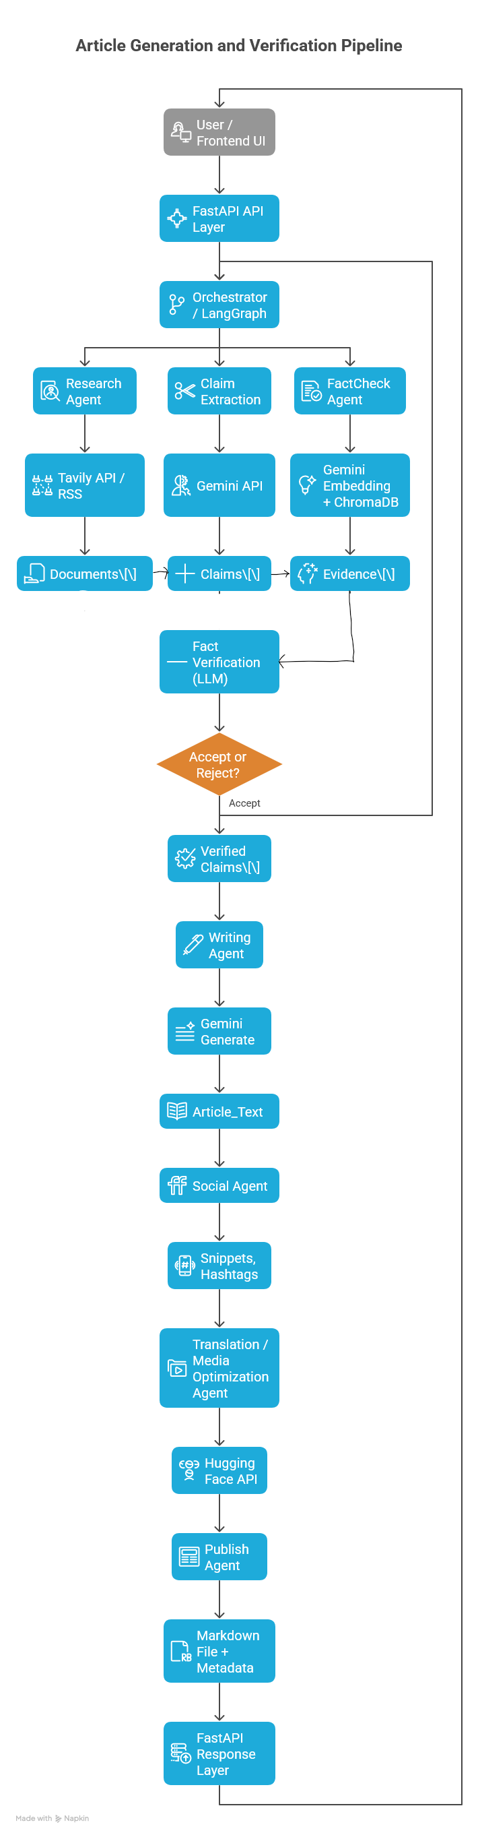
Work Flow
School of Computer Science and Engineering

Slide 9
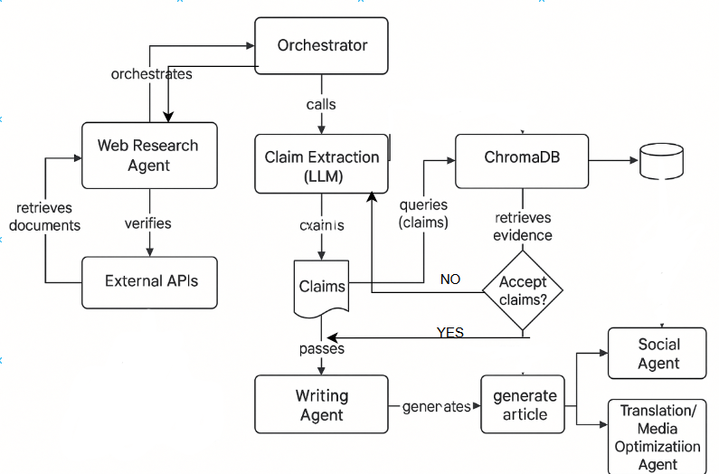
Agent Interaction Flow
Claims
School of Computer Science and Engineering

Slide 10
Work flow
1. Input:
A topic provided by the user (e.g., “Latest AI regulations in the EU”).
2.Research Agent
Retrieves the top-K most relevant and recent documents or web articles related to the topic using Tavily API and LangChain retrievers.
3.Claim Extraction (LLM-based)
Processes the gathered documents and extracts concise factual statements or key claims using the Gemini LLM.
4. Fact-Checking Agent
Verifies each extracted claim against the stored or retrieved evidence from ChromaDB to ensure accuracy and reliability.
5. Writing Agent
Generates a coherent and structured news article based only on the verified claims, maintaining factual integrity and readability.
6.Social Agent
Summarizes the article into short, catchy snippets suitable for social media posts or headlines.
School of Computer Science and Engineering

Slide 11
Work flow
7. Publish Agent
Formats and saves the final verified article in Markdown (.md) format for easy publishing or website integration.
8. Translation Agent
Translates the article into a target language using Hugging Face translation models (as a fallback).
9. Output:
A fact-verified, well-written news article with accompanying social media post summaries, ready for publication.
School of Computer Science and Engineering

Slide 12
Implementation Details
NewsForge automates the end-to-end news creation pipeline using multiple AI agents coordinated via FastAPI and LangChain.
Layer | Technology | Purpose
Frontend | HTML, CSS, JavaScript | User interface to enter topics & view generated articles
Backend | Python, FastAPI, Uvicorn | REST API for agent communication
Orchestration | LangChain / LangGraph | Multi-agent workflow coordination
LLM Backend | Gemini API (Pro & Embedding) | Text generation, summarization, embeddings
Vector Store | ChromaDB | Evidence storage & retrieval for fact-checking
Web Research | Tavily API, RSS | Fetch factual content from the web
Translation Fallback | Hugging Face API | Multi-language article support
Environment Config | .env, python-dotenv | Secure key management
Testing Tools | pytest, diagnose_imports.py | Validation & import diagnostics
School of Computer Science and Engineering

Slide 13
Results
Observed Results Successfully generated complete, coherent news articles for various topics.
Articles included evidence sources, provenance links, and social media snippets.
Frontend progress tracker accurately displayed each pipeline stage (Research → FactCheck → Writing → Publish).
Mock mode allowed system testing without live API calls.
FastAPI server ran locally and responded successfully on http://127.0.0.1:8000.
School of Computer Science and Engineering

Slide 14
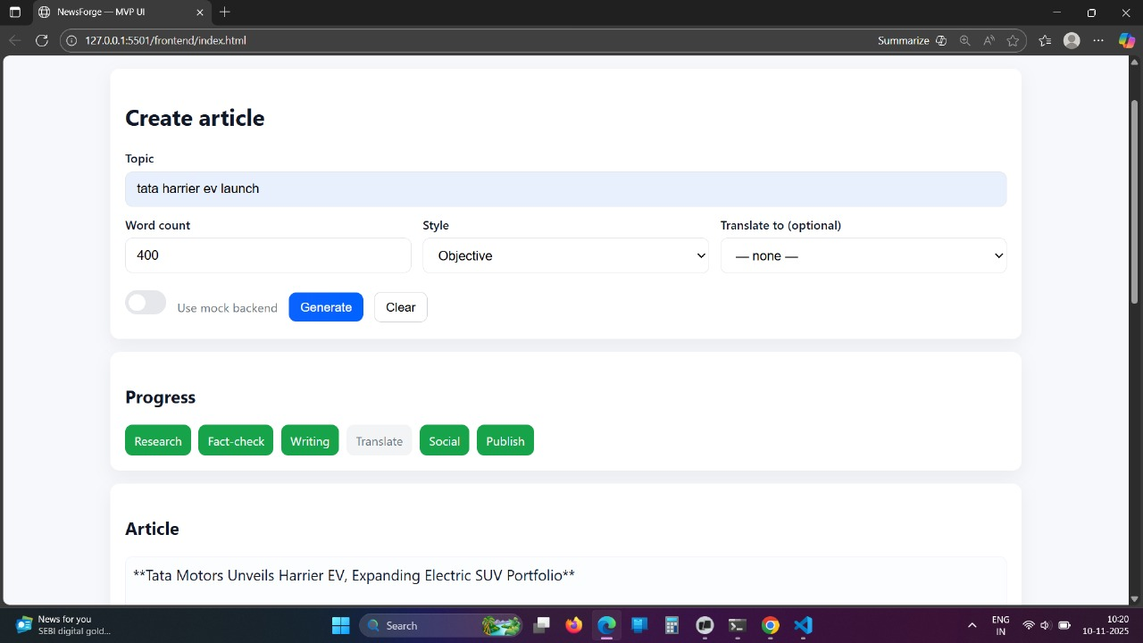
Results
School of Computer Science and Engineering

Slide 15
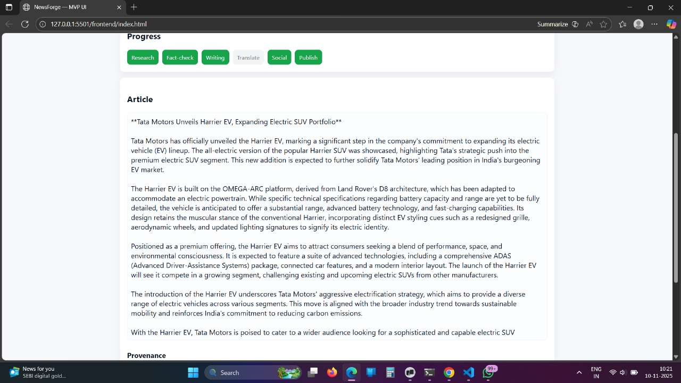
Results
School of Computer Science and Engineering

Slide 16
Conclusion
The project demonstrates the practical application of agentic AI and multi-agent orchestration for automated journalism.
It shows how LLMs, combined with retrieval-augmented reasoning and autonomous collaboration, can create reliable, fact-checked content efficiently.
Future enhancements may include: Human-in-the-loop review for quality assurance Real-time data integration Continuous learning from feedback
School of Computer Science and Engineering

Slide 17
Thank You
Click here for the portfolio
School of Computer Science and Engineering

